Slide 1
Big Data Frameworks
Ramesh Ragala
VIT Chennai

Slide 2

Hadoop - Introduction
An Open source software framework (Apache Project)
Originally developed by Yahoo (but originated from Google)
Goal:
storage and processing of data-sets at massive scale
Infrastructure:
clusters of commodity hardware
Core Components:
HDFS → distributed file system
Map Reduce → programming model for large scale data processing
Eco Systems
Pig, Hive, Hbase, mahout, zookeeper
9 February 2019
2

Slide 3
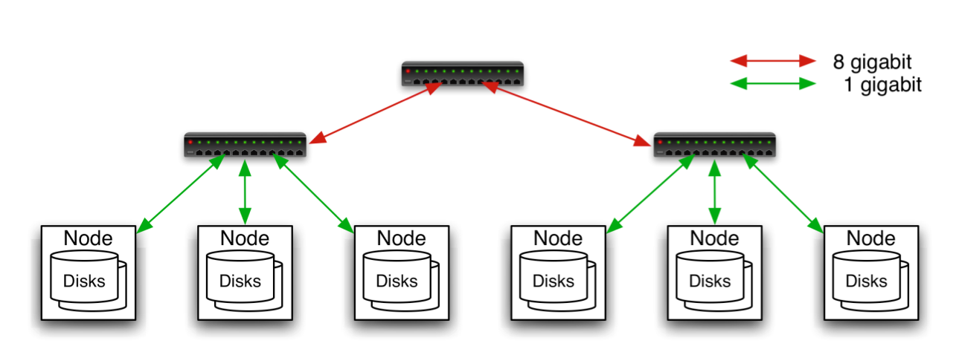
Commodity Hardware
Aggregation switch
Rack switch
It involves the use of large numbers of already-available computing components for parallel computing, to get the greatest amount of useful computation at low cost
Typically in 2 level architecture
Nodes are commodity PCs
30-40 nodes/rack
Uplink from rack is 3-4 gigabit
Rack-internal is 1 gigabit
Notes:
3

Slide 4
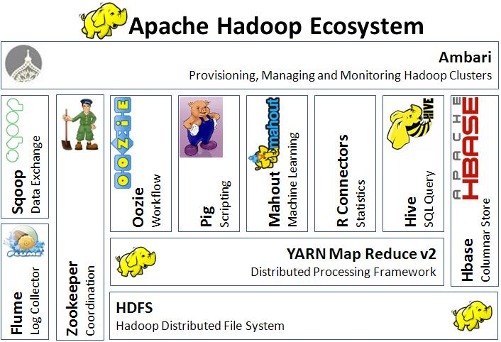
Hadoop - Ecosystem
9 February 2019
4

Slide 5
Hadoop - History
2003: Google publishes about its cluster architecture & distributed file system (GFS)
2004: Google publishes about its MapReduce programming model used on top of GFS
Written in C++
closed-source, Python and Java APIs available to Google programmers only
2006: Apache & Yahoo! → Hadoop & HDFS (Doug Cutting and Mike Cafarella)
open-source, Java implementations of Google MapReduce and GFS
a diverse set of APIs available to public
2008: becomes an independent Apache project
Yahoo! uses Hadoop in production
9 February 2019
5

Slide 6

Hadoop users
9 February 2019
6

Slide 7
What is HDFS
Hadoop Distributed File System
Data is organized into files and directories
Files are divided into uniform sized blocks (default 128MB) and distributed across cluster nodes
HDFS exposes block placement so that computation can be migrated to data
Blocks are replicated (default 3) to handle hardware failure
Replication for performance and fault tolerance (Rack-Aware placement)
HDFS keeps checksums of data for corruption detection and recovery
Good for
Large files
Streaming Data Access
Bad for
Lots of small files
Random Access
Low – Latency Access
9 February 2019
7

Slide 8
What is HDFS
HDFS is a Java-based file system that provides scalable and reliable data storage, and it was designed to span large clusters of commodity servers
HDFS has demonstrated production scalability of up to 200 PB of storage
HDFS has demonstrated a single cluster of 4500 servers, supporting close to a billion files and blocks.
HDFS is a scalable, fault-tolerant, distributed storage system that works closely with a wide variety of concurrent data access applications, coordinated by YARN.
9 February 2019
8

Slide 9
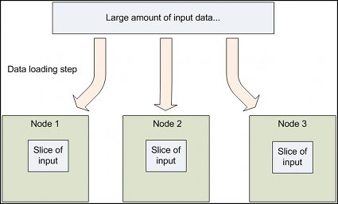
Design of HDFS
GFS like Design
HDFS supports parallel reading and processing of the data
Read, Write, Rename and Append
Optimized for streaming reads/writes of large files
Master – Worker Architecture
Master
Single Name node for managing FS meta
Slaves
Multiple Data Nodes for storing data
One more:
Secondary name node for check-pointing
9 February 2019
9

Slide 10
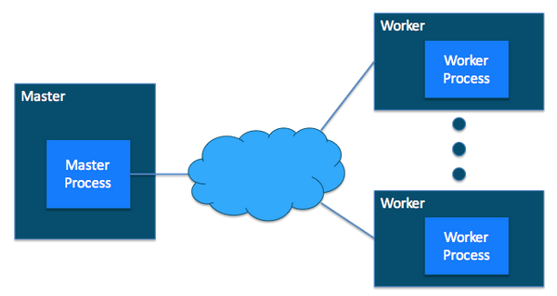
Design of HDFS
9 February 2019
10

Slide 11
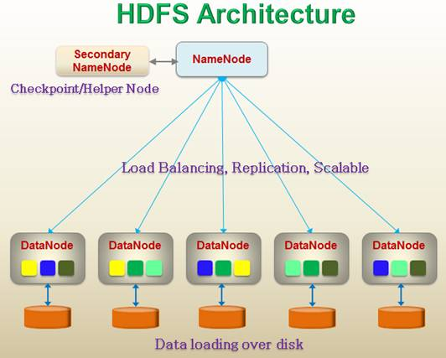
HDFS Architecture
9 February 2019
11

Slide 12
HDFS Master (Name Node)
Manages filesystem namespace tree and holding the entire namespace tree in RAM
Maps a file name to a set of blocks
Maps a block to the DataNodes where it resides
Files and directories are represented by i-node
Mapping i-node to list of blocks + locations
Authorization & Authentication
Checkpoint & journal namespace changes
Mapping of Data node to list of blocks
Monitor Data node health
Actively monitors the number of replicas of block and
replicate missing blocks
Keeps ALL namespace in memory
It also executes file system operations such as renaming, closing, and opening files and directories.
Cluster Configuration Management
Types of Meta Data:
List of Files
List of Blocks for each files
List of data nodes for each block
File attributes like.. Creation time, replication factor, etc.
9 February 2019
12

Slide 13
HDFS (Data Node)
Handle block storage on multiple volumes & block integrity
Clients access the blocks directly from data nodes
Periodically send heartbeats and block reports to Name node
Blocks are stored as underlying OS’s files
9 February 2019
13

Slide 14
HDFS
When a replica of a block is lost due to a Datanode failure or disk failure, the namenode creates another replica of block.
The NameNode does not directly send requests to DataNodes.
It sends instructions to the datanodes by replying to heartbeats sent by those datanodes.
The instructions include commands to:
replicate blocks to other nodes,
remove local block replicas,
re-register and send an immediate block report, or
shut down the node.
9 February 2019
14

Slide 15

HDFS Architecture
9 February 2019
15

Slide 16
HDFS
HDFS Recovery Time from Single DataNode Failure:
The HDFS NameNode ensures that each block is sufficiently replicated.
When it detects the loss of a DataNode, it instructs remaining nodes to maintain adequate replication by creating additional block replicas.
For each lost replica, the NameNode picks a (source, destination) pair where the source is an available DataNode with another replica of the block and the destination is the target for the new replica.
Estimate a lower bound for the recovery time:
Simple Assumptions:
The maximum IO bandwidth of each disk is 100MB/s (reads + writes).
This is true for the vast majority of clusters that use spinning disks.
9 February 2019
16

Slide 17
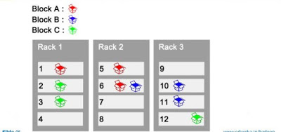
HDFS Replica and Rack Awareness
HDFS follows rack awareness for never loss all the data if entire rack fails.
Rules for Rack Awareness
Need to place the first replica of block in near
available rack
The second replica of block is not placed in
the same rack where the first replica is placed
The third replica should place in where the
second replica is placed but in the different node.
9 February 2019
17

Slide 18
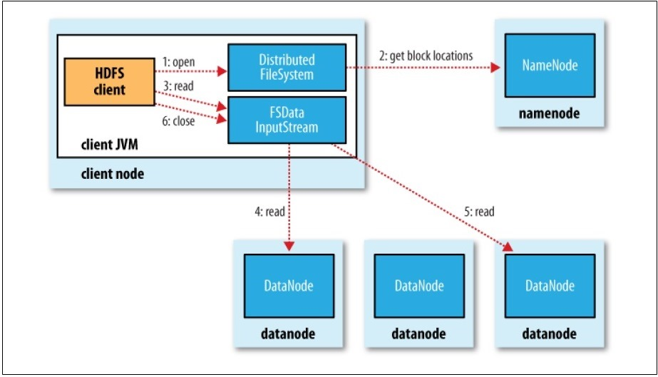
Data Flow: Anatomy of a File Read
To get an idea of how data flows between the client interacting with HDFS, namenode and datanodes
9 February 2019
18

Slide 19
Data Flow: Anatomy of a File Read
The steps for reading data from HDFS:
Step-1: The client opens the file it wishes to read by calling open() on the FileSystem object, which for HDFS is an instance of DistributedFileSystem.
Step-2: DistributedFileSystem calls the namenode, using RPC,
To determine the locations of the blocks for the first few blocks in the file,
For each block, the namenode returns the addresses of the datanodes that have a copy of that block
The datanodes are sorted according to their proximity to the client.
Short-Circuit local reads → if client is its self a datanode
The DistributedFileSystem returns an FSDataInputStream (an input stream that supports file seeks) to the client for it to read data from.
FSDataInputStream in turn wraps a DFSInputStream, which manages the datanode and namenode I/O.
Step-3: The client then calls read() on the stream.
9 February 2019
19

Slide 20
Data Flow: Anatomy of a File Read
The steps for reading data from HDFS:
DFSInputStream, which has stored the datanode addresses for the first few blocks in the file, then connects to the first (closest) datanode for the first block in the file
Data is streamed from the datanode back to the client, which calls read() repeatedly on the stream.
Step-5: When the end of the block is reached, DFSInputStream will close the connection to the datanode, then find the best datanode for the next block
Blocks are read in order with the DFSInputStream opening new connections to datanodes as the client reads through the stream.
Step-6: When the client has finished reading, it calls close() on the FSDataInputStream
9 February 2019
20

Slide 21
Data Flow: Anatomy of a File Read
The steps for reading data from HDFS:
During reading, if the DFSInputStream encounters an error while communicating with a datanode, then it will try the next closest one for that block.
It will also remember datanodes that have failed so that it doesn’t needlessly retry them for later blocks.
The DFSInputStream also verifies checksums for the data transferred to it from the datanode.
If a corrupted block is found, it is reported to the namenode before the DFSInputStream attempts to read a replica of the block from another datanode.
The client contacts datanodes directly to retrive data with the help of namenode
9 February 2019
21

Slide 22
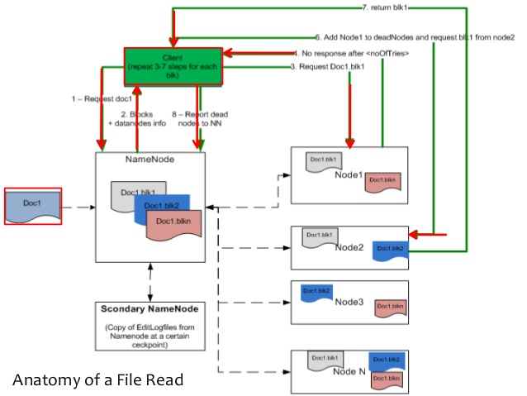
Data Flow: Anatomy of a File Read
9 February 2019
22

Slide 23
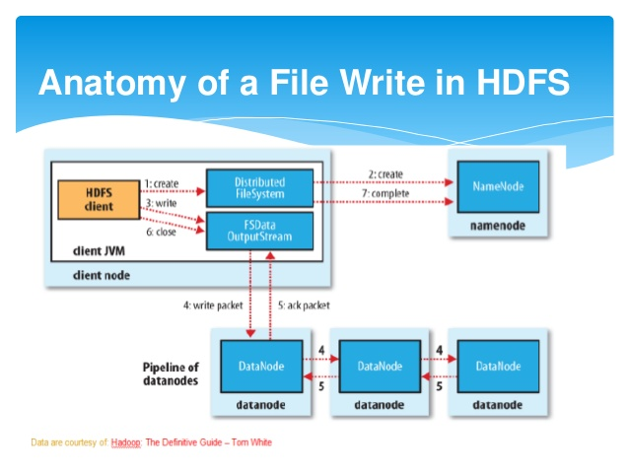
Data Flow: Anatomy of File Write
9 February 2019
23

Slide 24
Data Flow: Anatomy of File Write
To write a file into HDFS, client needs to interact with name node
Namenode provides the address of the slave(Data node) on which client will start writing data
As soon as client finishes writing the block, the slave starts copying the block to another slave which in turn copy the block into another slave (default is 3)
After required replicas are created then it will send the acknowledgement to the client
Authentication process is same like file read
9 February 2019
24

Slide 25
Data Flow: Anatomy of File Write
The steps to follows to write a file in HDFS:
Step-1: The client creates the file by calling create() on DistributedFileSystem.
Step-2: DistributedFileSystem makes an RPC call to the namenode to create a new file in the filesystem’s namespace, with # blocks associated with it.
The namenode performs various checks to make sure the file doesn’t already exist, and that the client has the right permissions to create the file
If these checks pass, the namenode makes a record of the new file; otherwise, file creation fails and the client is thrown an IOException.
The DistributedFileSystem returns an FSDataOutputStream for the client to start writing data to.
Step-3: As in the read case, FSDataOutputStream wraps a DFSOutputStream, which handles communication with the datanodes and namenode.
As the client writes data, DFSOutputStream splits it into packets, which it writes to an internal queue, called the data queue.
9 February 2019
25

Slide 26
Data Flow: Anatomy of File Write
The steps to follows to write a file in HDFS:
The data queue is consumed by the DataStreamer, whose responsibility it is to ask the namenode to allocate new blocks by picking a list of suitable datanodes to store the replicas.
The list of datanodes forms a pipeline— assuming the replication level is three, so there are three nodes in the pipeline.
Step-4: The DataStreamer streams the packets to the first datanode in the pipeline, which stores the packet and forwards it to the second datanode in the pipeline.
Similarly, the second datanode stores the packet and forwards it to the third (and last) datanode in the pipeline.
DFSOutputStream also maintains an internal queue of packets that are waiting to be acknowledged by datanodes, called the ack queue.
Step-5: A packet is removed from the ack queue only when it has been acknowledged by all the datanodes in the pipeline
9 February 2019
26

Slide 27
Data Flow: Anatomy of File Write
The steps to follows to write a file in HDFS:
It’s possible, but unlikely, that multiple datanodes fail while a block is being written. As long as dfs.replication.min replicas (default one) are written, the write will succeed, and the block will be asynchronously replicated across the cluster until its target replication factor is reached (dfs.replication, which defaults to three).
Step-6: When the client has finished writing data, it calls close() on the stream.
Step-7: This action flushes all the remaining packets to the datanode pipeline and waits for acknowledgments before contacting the namenode to signal that the file is complete.
The namenode already knows which blocks the file is made up of (via Data Streamer asking for block allocations), so it only has to wait for blocks to be minimally replicated before returning successfully.
HDFS provides a method for forcing all buffers to be synchronized to the datanodes via the sync() method on FSDataOutputStream.
Writes the blocks in parallel manner
Writes the replicas in sequential manner
Writing blocks follows the rack awareness rules.
9 February 2019
27

Slide 28
MapReduce Overview
Programming model used by Google
MapReduce offers a solution to existing problems by bringing computation close to data thereby minimizing data movement
A combination of the Map(transformed) and Reduce(aggregated) models with an associated implementation
It is a simple programming model designed to process large volumes of data in parallel by dividing the job into a set of independent tasks.
MapReduce is highly scalable and can be used across many computers.
Many small machines can be used to process jobs that normally could not be processed by a large machine.
Limitation of Map-Reduce Programming
Map and Reduce jobs are stateless. → reduce jobs have to wait for map jobs to be completed first → limits the maximum parallelism → YARN born
9 February 2019
28

Slide 29
MapReduce Overview
MapReduce is the key algorithm that the Hadoop data processing engine uses to distribute work around a cluster.
Decomposing the data processing applications into mappers and reducers is sometimes non-trivial.
Once the application have written in map-reduce form, scaling the application over cluster is a just a configuration change only.
9 February 2019
29

Slide 30
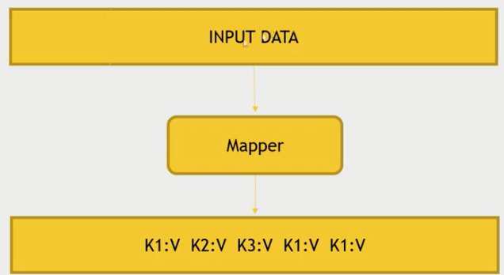
Map Abstraction
The Mapper converts raw source data into key/value pairs
Inputs a key/value pair
Key is a reference to the input value
Value is the data set on which to operate
Evaluation
Function defined by user
Applies to every value in value input
Might need to parse input
Produces a new list of key/value pairs
Can be different type from input pair
9 February 2019
30

Slide 31
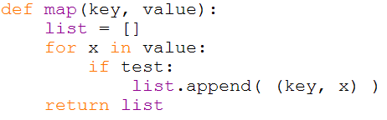
Map Example
9 February 2019
31

Slide 32
Distributed Grep
Split data
grep
matches
Very
big
data
Split data
grep
matches
cat
All
matches
Split data
grep
matches
Split data
grep
matches

Slide 33
Distributed Word Count
Split data
count
count
Split data
count
count
Very
big
data
merged
count
Split data
count
count
merge
Split data
count
count

Slide 34
Map+Reduce
R
E
D
U
C
E
Very
big
data
M
A
P
Partitioning
Function
Result
Map:
Accepts input key/value pair
Emits intermediate key/value pair
Reduce :
Accepts intermediate key/value* pair
Emits output

Slide 35
Reduce Abstraction
Starts with intermediate Key / Value pairs
Ends with finalized Key / Value pairs
Starting pairs are sorted by key
Iterator supplies the values for a given key to the Reduce function.
Typically a function that:
Starts with a large number of key/value pairs
One key/value for each word in all files being greped (including multiple entries for the same word)
Ends with very few key/value pairs
One key/value for each unique word across all the files with the number of instances summed into this entry
Broken up so a given worker works with input of the same key.
9 February 2019
35

Slide 36
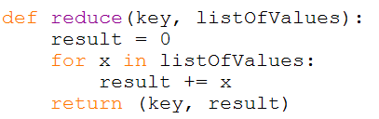
Reduce Example
9 February 2019
36

Slide 37
How Map and Reduce Work Together

Slide 38
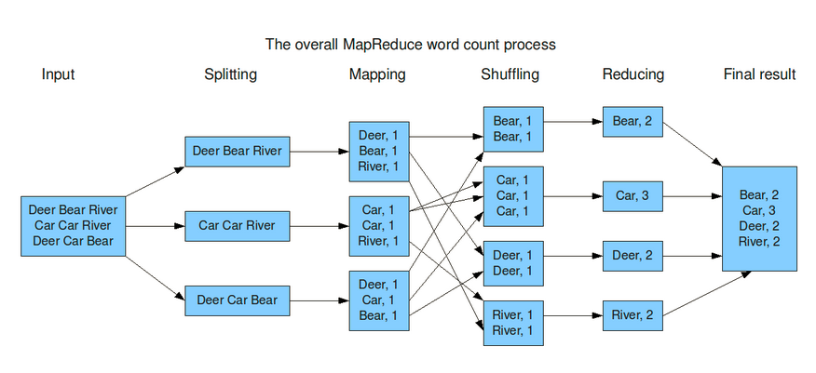
Mapreduce Example
9 February 2019
38

Slide 39
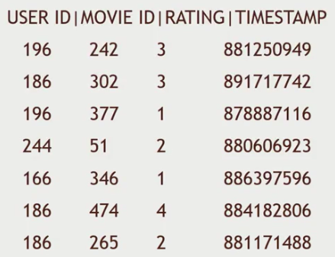

Map Reduce Example - 2
Dataset : MovieLens dataset
How many movies did each user rate in the MovieLens dataset?
9 February 2019
39

Slide 40
Map Reduce Example - 2
Key will be the UserID
Values will be MovieID → aggregating
9 February 2019
40

Slide 41
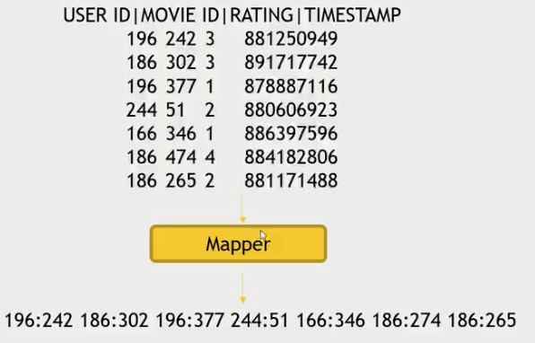
Map Reduce Example - 2
Map users to movies they watched:
9 February 2019
41

Slide 42
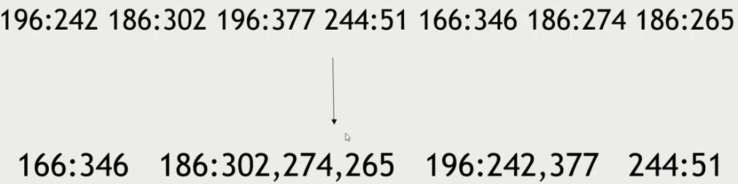
Map Reduce Example - 2
Map-Reduce sorts and groups the mapped data (“Shuffle and Sort”)
9 February 2019
42

Slide 43
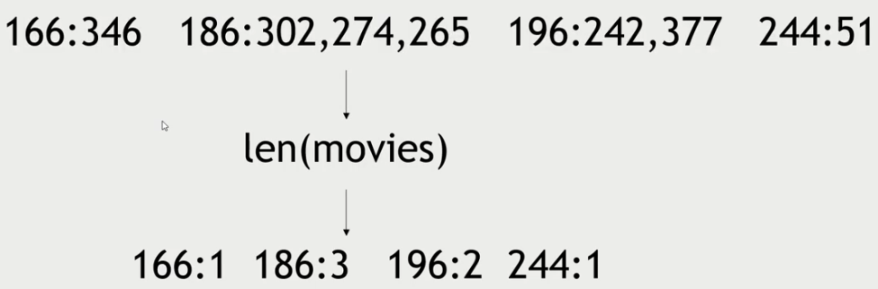
Map Reduce Example - 2
Reducer Process each key’s values
9 February 2019
43

Slide 44
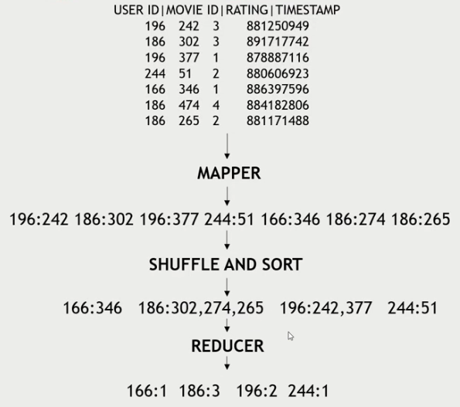
Map Reduce Example - 2
Final
9 February 2019
44

Slide 45
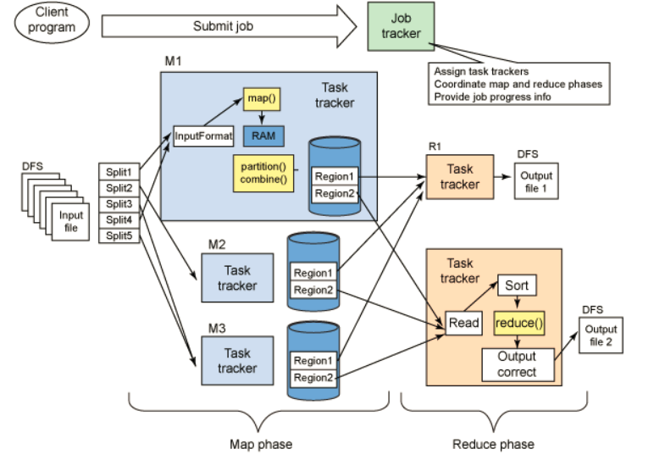
Mapreduce data flow
9 February 2019
45

Slide 46

9 February 2019
46

